Slide 1
UML Project E-Guard
Alzraji Abdulla-Ali

Slide 2
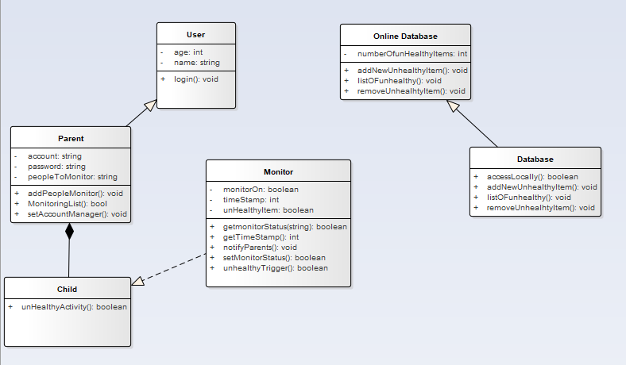
Class Diagram
Representing all the classes to be used in the application and their relationships with each other
There exists a composition between the parent and child. The child can’t exist without the parent class

Slide 3
State Diagrams

Slide 4
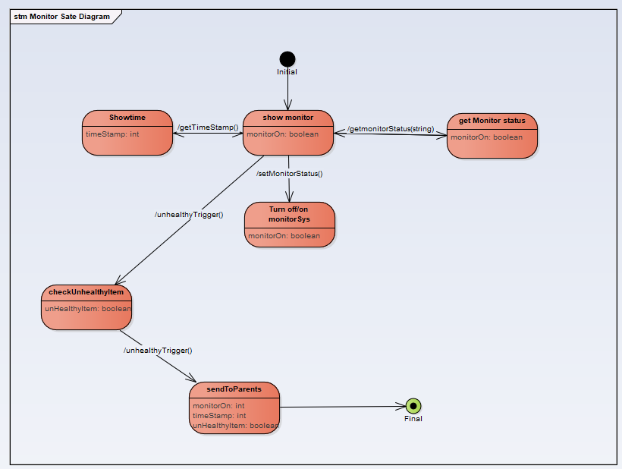
Monitor State Diagram
Shows what goes on with the object throughout the application process

Slide 5
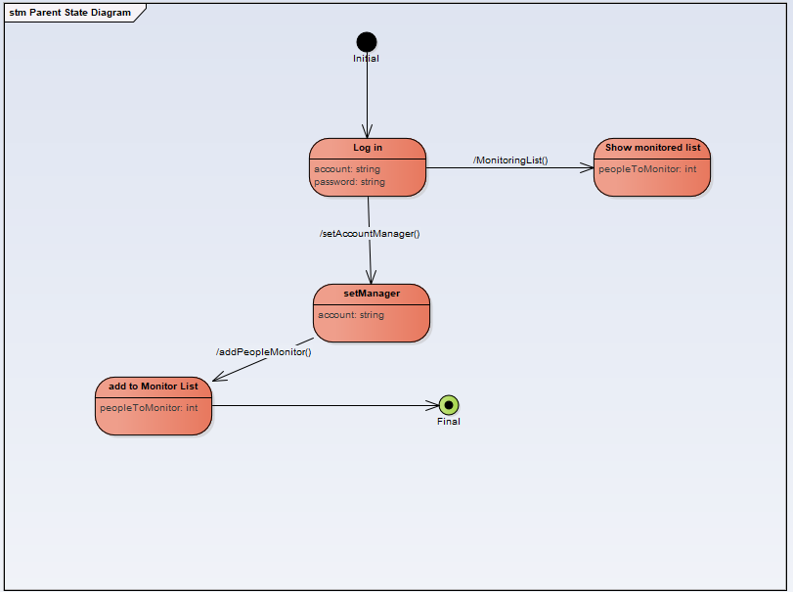
Parent State Diagram
The focus is on the state of the parent as the application is running

Slide 6
Sequence Diagrams

Slide 7
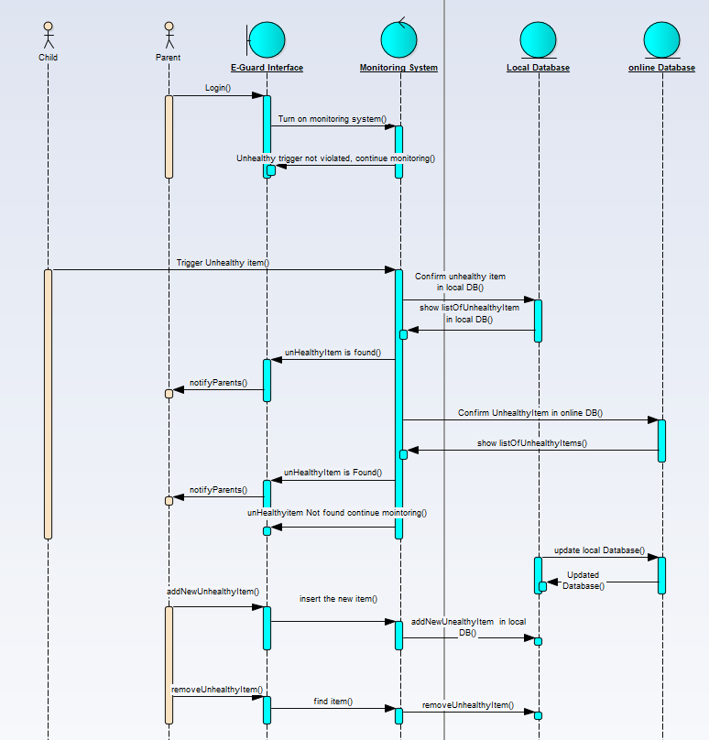
This Diagram shows the events that happen in the E-Guard application in order
The control object shows the control tasks that are implemented by the application. Also combine the Entity and Boundary Objects

Slide 8
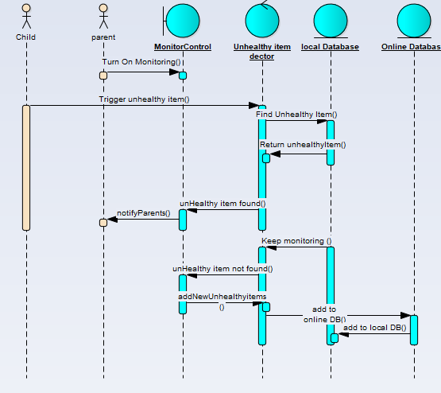
Monitoring System diagram
The sequence highlights the events of the monitoring system.
The parent must first turn on the system, this allows the application to keep searching for unhealthy items
We also see the parent's action to add a new unhealthy item to the DB

Slide 9
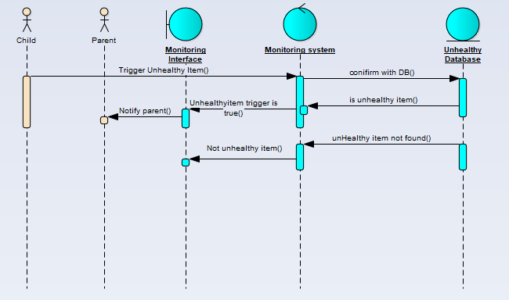
Confirmed suspicious activity diagram
In this sequence the child triggers the monitoring system first then monitoring system reacts depending on whether the trigger is confirmed to be unhealthy

Slide 10
Thank you

